Slide 1
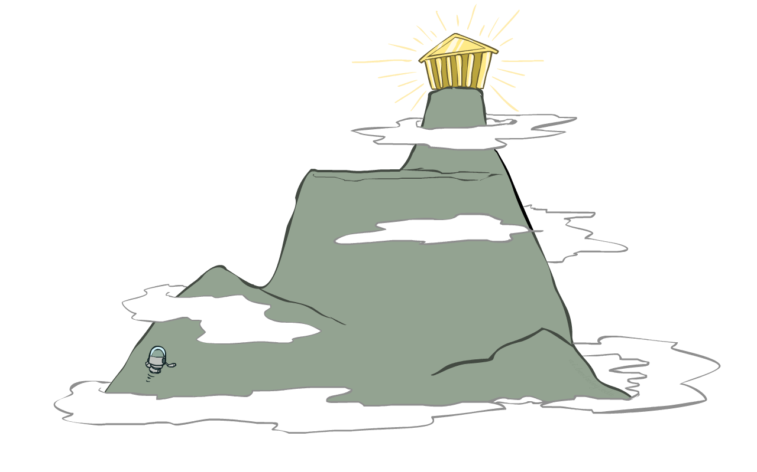
CSCD84: Artificial Intelligence
Tutorial Week 4: Local search
[R&N, 4.1][P&M, 4.6-4.7]
Erfan Meskar
Winter 2024, University of Toronto, Scarborough
[These slides were adapted from Dan Klein and Pieter Abbeel (ai.berkeley.edu), Francisco Estrada, Bahar Aameri and Sonya Allin, Fahiem Bacchus, David Poole and Alan Mackworth, Percy Liang and Dorsa Sadigh, Lisa Jing Yan, Cesare Tinelli, Dieter Fox, and Dan Weld.]

Slide 2
📅 Today
Part 1: Complementary Material
Local Search
Hill Climbing
Simulated Annealing
Local Beam Search
Genetic Algorithms
Part 2: Backtracking Extra Examples

Slide 3
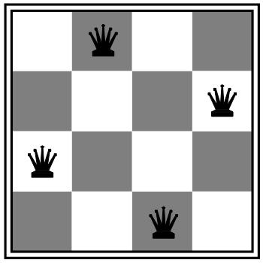
🔎 Local search algorithms
In many optimization problems, path is irrelevant; the goal state is the solution
Then state space = set of “complete” configurations; find configuration satisfying constraints, e.g., n-queens problem;
In such cases, can use iterative improvement algorithms: keep a single “current” state, try to improve it
Constant space, suitable for online as well as offline search

Slide 4
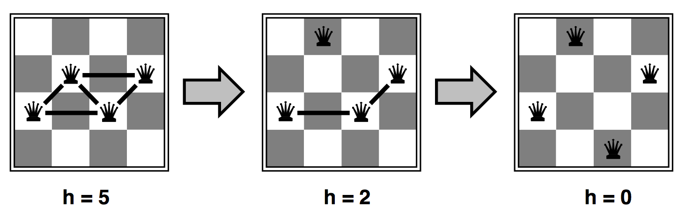
👸 Heuristic for n-queens problem
Goal: n queens on board with no conflicts, i.e., no queen attacking another (no queen in the same row, column, or diagonal as another)
States: n queens on board, one per column
Actions: move a queen in its column
Heuristic value function: number of conflicts

Slide 5
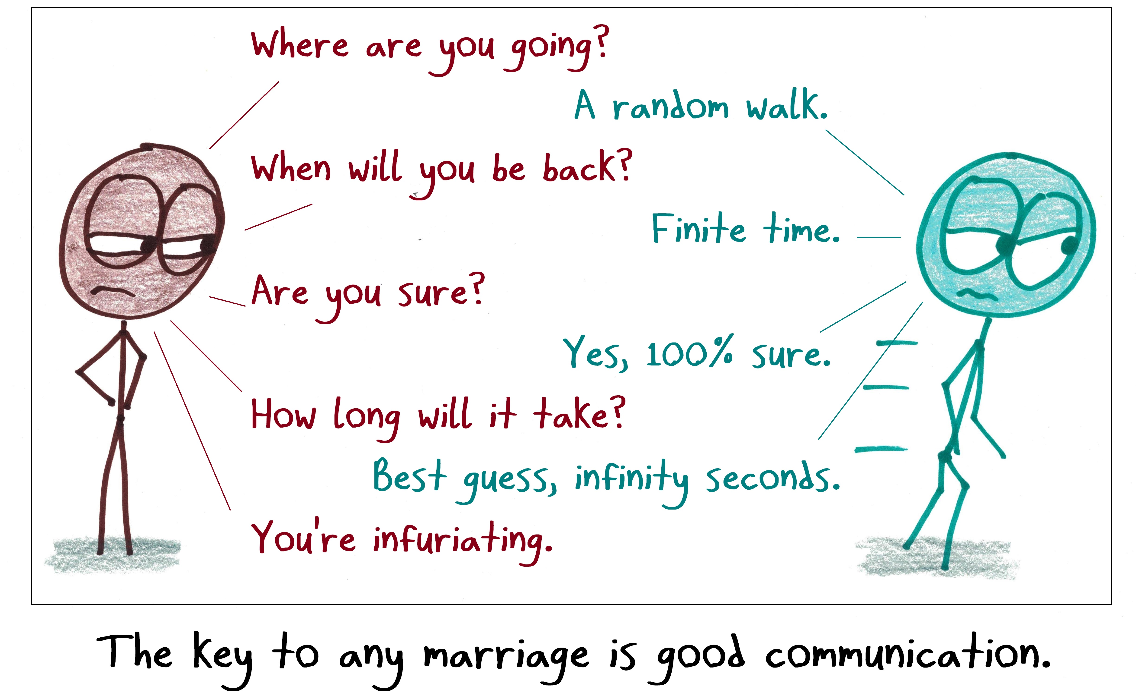
Easy Algorithms
Random Sampling
Randomly generate a state (Any position for any queen)
Asymptotically complete
Random Walk
Randomly select a neighbouring state of the current state
Asymptotically complete

Slide 6
🚵 Hill Climbing
Simple, general idea:
Start wherever
Keep track of a single state – current state
Repeat: move to the best neighbouring state
What does best mean?
We use heuristics to define the best
If no neighbours better than current ones, quit
What’s bad about this approach:
Not complete
Not optimal
What’s good about this approach:
Can often find reasonable solutions for large state spaces
Fast and uses very little memory

Slide 7
🚵 Hill-climbing algorithm (Greedy Local Search)
function HILL-CLIMBING(problem) returns a state
current ← make-node(problem.initial-state)
loop do
neighbor ← a highest-valued successor of current
if neighbor.value ≤ current.value then
return current.state
current ← neighbor
“Like climbing Everest in thick fog with amnesia”
(bad visibility and bad memory)

Slide 8
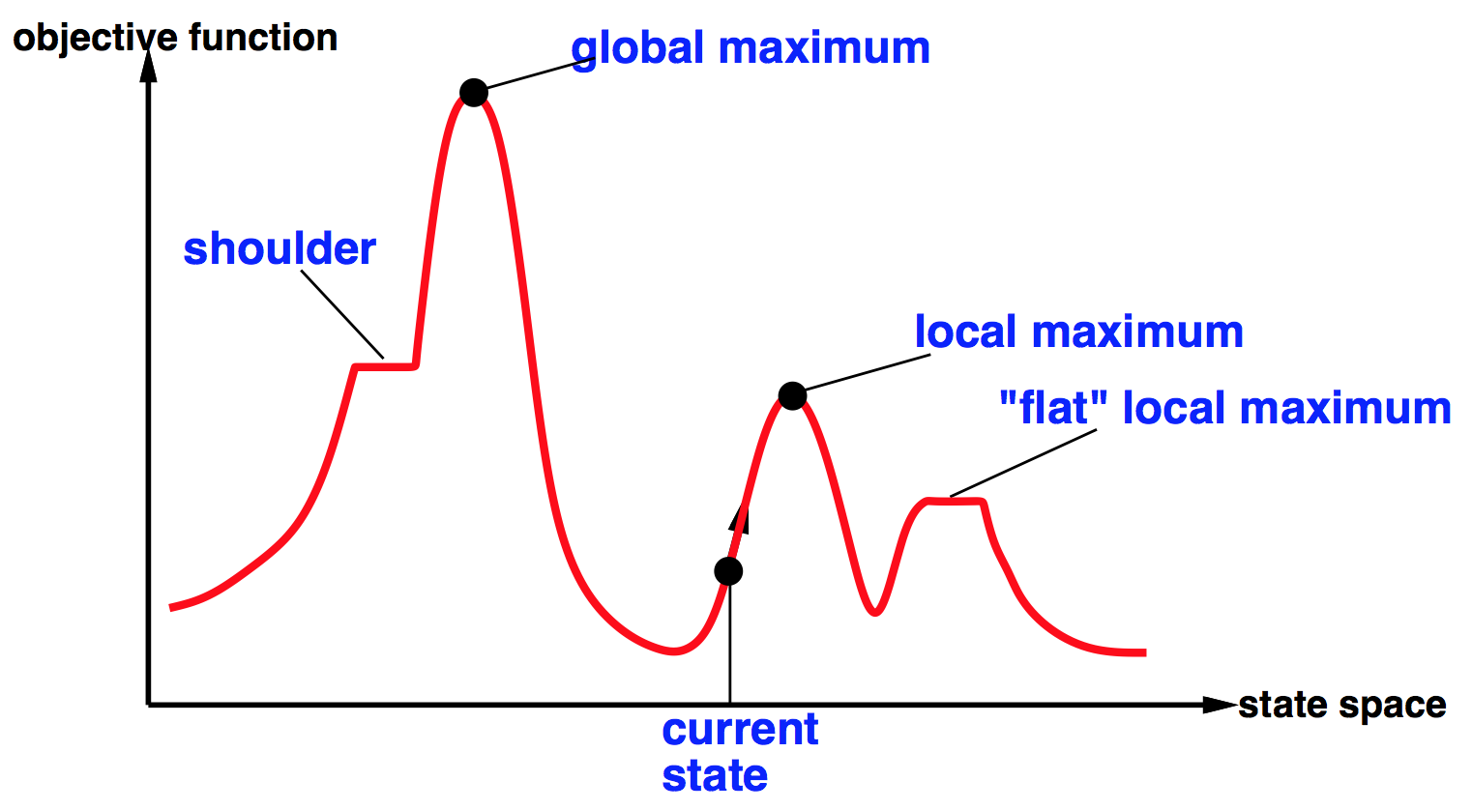
🌎 ⬆️ Global and local maxima

Slide 9
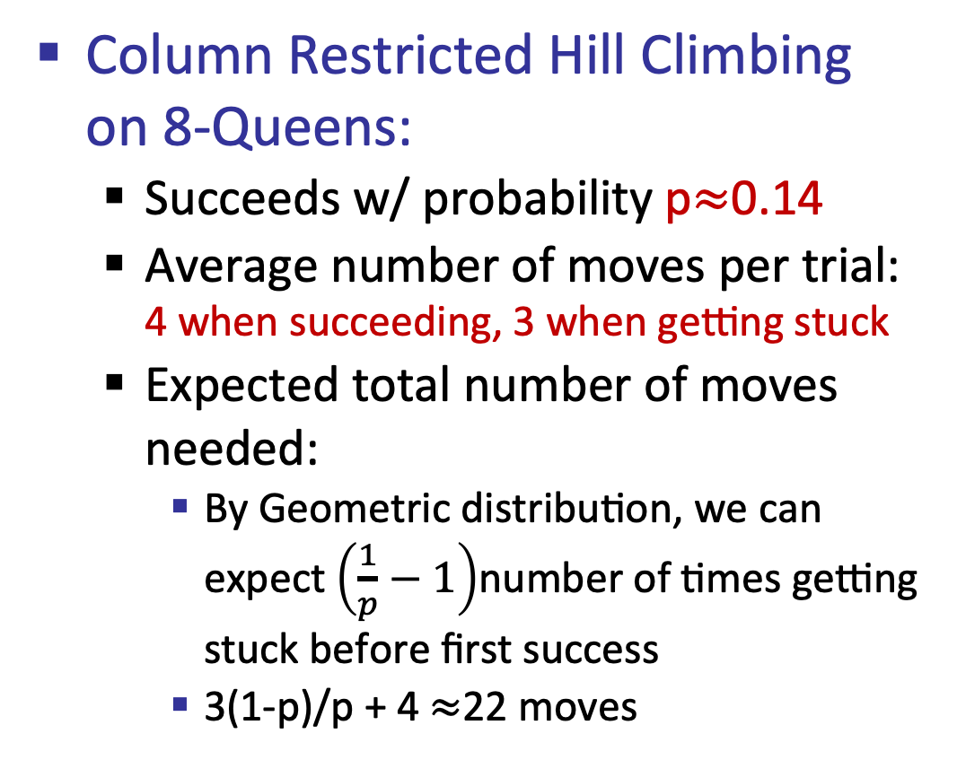
👸 🚵 Hill-climbing on the 8-queens problem
Column Restricted Hill Climbing on 8-Queens:
Succeeds w/ probability p$≈$0.14
Average number of moves per trial: 4 when succeeding, 3 when getting stuck
Expected total number of moves needed:
By Geometric distribution, we can expect $\left(\frac{1}{p}−1\right)$number of times getting stuck before first success
3(1-p)/p + 4 $≈$22 moves

Slide 10
🤞 🚵 Stochastic Hill-climbing
Random restarts
“If at first you don’t succeed, try, try again”
Conducts a series of Hill-climbing searches from randomly generated initial states, until a goal is found.
It is complete
Random sideways moves
Keep going when we reach a plateau
Escape from shoulders
Loop forever on flat local maxima
Therefore, we can limit the number of consecutive sideways moves,
stopping after say 100 consecutive moves
Taboo Search (constant size list of nodes)

Slide 11
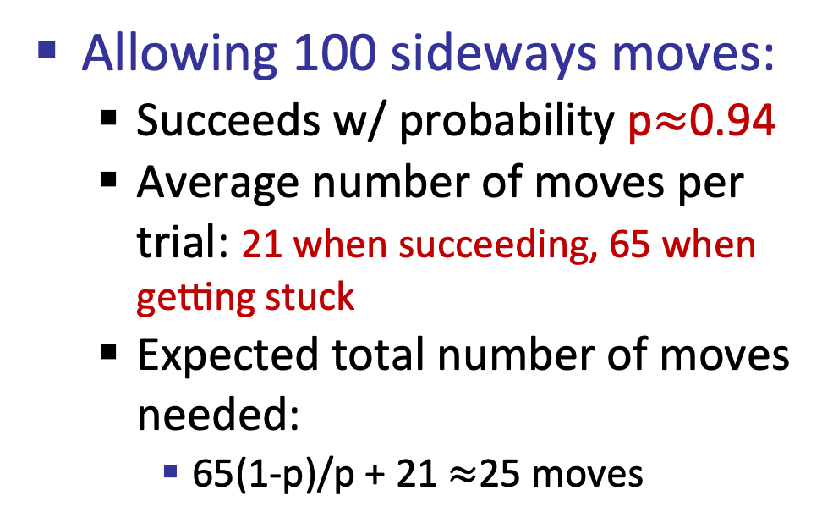
👸 🚵 Hill-climbing on the 8-queens problem
Allowing 100 sideways moves:
Succeeds w/ probability p$≈$0.94
Average number of moves per trial: 21 when succeeding, 65 when getting stuck
Expected total number of moves needed:
65(1-p)/p + 21 $≈$25 moves

Slide 12
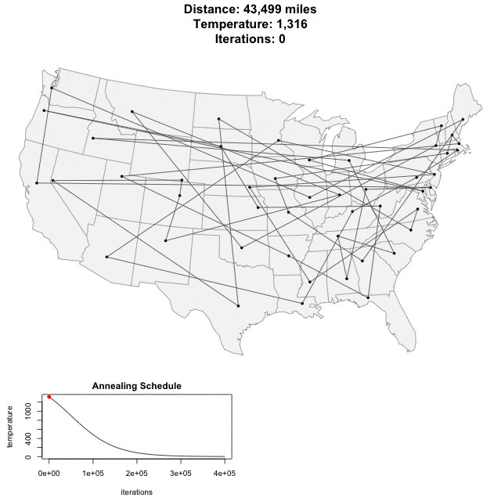
⛏️ Simulated annealing
Resembles the annealing process used to cool metals slowly to reach an ordered/Crystallized (low-energy) state
Basic idea:
Allow “bad” moves occasionally, depending on “temperature”
High temperature => more bad moves allowed, shake the system out of its local minimum
Gradually reduce temperature according to some schedule

Slide 13

⛏️ Simulated annealing algorithm
function SIMULATED-ANNEALING(problem,schedule) returns a state
\\ inputs: problem, a problem
\\ schedule, a mapping from time to “temperature”
current ← problem.initial-state
for t = 1 to ∞ do
T ←schedule(t) \\ a temperature that controls the prob. of downward steps if T = 0 then return current next ← a randomly selected successor of current
∆E ← next.value – current.value \\ change in energy if ∆E > 0 then current ← next else current ← next only with probability e^{∆E/T}

Slide 14
⛏️ Simulated Annealing
Theoretical guarantee:
If T decreased slowly enough, will converge to optimal state!
Sounds like magic, but reality is reality:
The more downhill steps you need to escape a local optimum, the less likely you are ever to make them all in a row
“Slowly enough” may mean exponentially slowly
Random restart hill climbing also converges to the optimal state…
Simulated annealing and its relatives are a key workhorse in Very Large Scale Integration (VLSI) layout and other optimal configuration problems
Asymptotically Optimal

Slide 15
☰ Local beam search
Basic idea:
K copies of a local search algorithm, initialized randomly
For each iteration
Generate ALL successors from K current states
Choose best K of these to be the new current states
Problem:
Quite often, all K states end up on the same local hill.

Slide 16
☰ Beam search example (K=4)
X
7
X
7
8
9
10
9
X
8
9
9
8
9
10
9
10
8
10
7
9
9
X
6
X
5
X
7
X
3
6
8
9
X
7
9

Slide 17
🤞 Stochastic Local beam search ☰
Basic idea:
K copies of a local search algorithm, initialized randomly
For each iteration
Generate ALL successors from K current states
Choose a random K of these with a bias towards good ones to be the new current states

Slide 18
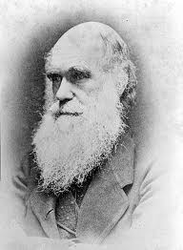
☰ Stochastic Local beam search 🧬
Why is this different from K local searches in parallel?
The searches communicate! “Come over here, the grass is greener!”
What other well-known algorithm does this remind you of?
Evolution!

Slide 19
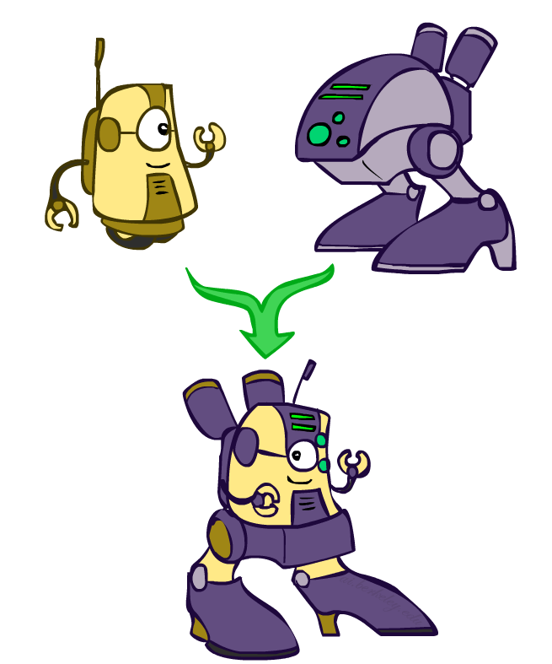
🧬 Genetic algorithms
Genetic algorithms use a natural selection metaphor
Successors are generated by combining two parent states
A state is represented as a string over a finite alphabet
Resample K individuals at each step (selection) weighted by the fitness function.
Fitness function is higher for better states
Combine pairwise crossover operators plus mutation to give a variety
Simulate Evolution
Random Selection
Crossover
Random Mutation

Slide 20
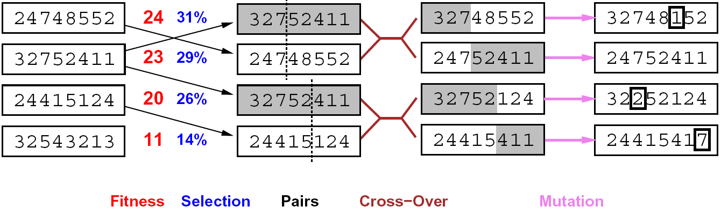
🧬 Genetic algorithms
Fitness function: Percentage calculation for probability
24/(24+23+20+11) = 31%
Crossover point is chosen at random

Slide 21
🧬 👸 Example: N-Queens
Does crossover make sense here?
What would mutation be?
What would a good fitness function be?

Slide 22
🧬 👸 Example: N-Queens
Does crossover make sense here?
Yes, but this is early on in the process
What would mutation be?
Changing the position of 1 queen
What would a suitable fitness function be?
Number of non-attacking pairs of queens (min = 0, max = 8x7/2 = 28)

Slide 23
Summary
Many configuration and optimization problems can be formulated as local search
General families of algorithms:
Hill-climbing
Simulated annealing (and other stochastic methods)
Local beam search: multiple interaction searches
Genetic algorithms: break and recombine states
Many machine learning algorithms are local searches

Slide 24
Today
Part 1: Complementary Material
Local Search
Random Restart
Random Sideway Moves
Simulated Annealing
Local Beam Search
Genetic Algorithm
Part 2: Backtracking Extra Examples

Slide 25

Feedback

Slide 26
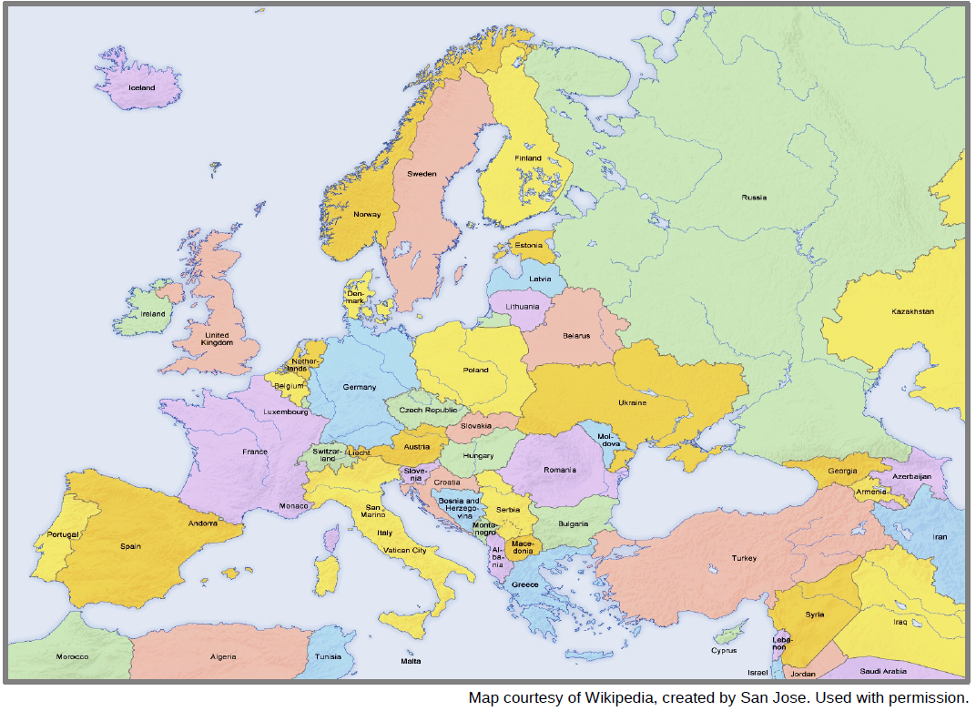
🗺️ Example: Map Colouring
That is Europe. Notice the map uses 6 colours but we can do better!

Slide 27
🗺️ Example: Map Colouring
We can colour the map using only four colours in such a way that no adjacent countries have the same colour.
To do so, we formulate the map colouring problem as graph, with nodes representing countries, and edges that represent adjacency
Q1 – Draw one such graph for the following countries:
Portugal, Spain, Andorra, France, Luxembourg, Belgium, Netherlands, Germany, Switzerland, Italy, Czech Republic, Austria, and San Marino

Slide 28
🗺️ Example: Map Colouring
We can find a suitable colouring using backtracking search. Assuming that you can use the four colours red, green, blue, yellow.
Q2 – What are the variables in this problem? What do they represent?
Q3 – What is the domain of each variable?
Q4 – Which variable(s) intervene in the largest number of constraints? (and how many?)
Q5 – Which variable(s) intervene in the least number of constraints? (and how many?)

Slide 29
🗺️ Example: Map Colouring
Recall the techniques you have learned during the lecture.
Q6 – In this graph, which variable should be chosen first? Which variable should be chosen next?
Q7 – Can you find a good cutset?

